Slide 1
Team 3 Better Software
Gary Johns
Dan Lain
Jose Flores

Slide 2
Vision
Create a cutting edge innovative project management software tool to allow small to medium sized companies to keep track of ongoing projects, employees, and costs. This tool shall allow the company to perform resource tracking, produce cost reports, and velocity tracking. This system will be developed by a small agile team consisting of three hard working developers.

Slide 3
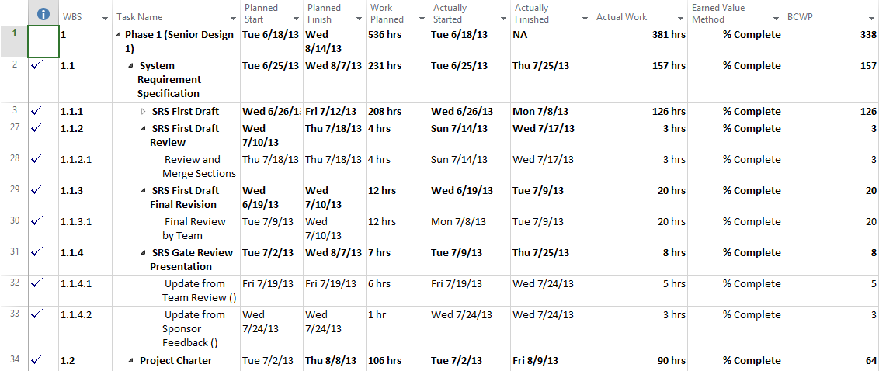
Concept

Slide 4
Competitors
Microsoft Project
Green Hoper
Excel
Agilefant
VersionOne
Open Workbench

Slide 5
Features
Multiple projects
Tracking
Cost
Hours
Velocity (Sprint Management)
Employees
Aggregate Reporting across multiple projects

Slide 6
The Difference
Unlike most popular project management tools suck as MS Project and Open Workbench
Easy to use
Made for small to medium sized companies
Core functionality without all the fluff
Simple Reports Preconfigured

Slide 7
Risks
Complicated Charting
Small Team
Limited Time
Many competing projects
Limited experience with technology stack

Slide 8
Project Plan

Slide 9
Outline
The project will be developed using staged delivery, which will be broken down into three increments at each producing a functioning prototype.
Three Man Team
Three Month Duration

Slide 10
Tools
Git Repository
Excel Bug Tracking
Weekly Status Meetings

Slide 11
Responsibilities
Dan Lain – Team Lead
Gary Johns – Lead Programmer
Jose Flores – Risk Management

Slide 12
Critical Path
Increments Build on the Work of the Previous Increment

Slide 13
Testing Methodology
Tests Performed on Each Module
Acceptance Tests Performed by Team
“Done” When Team Agrees

Slide 14
Increment 1 Deliverables
Inception
Database Design
Rough Interface
User Creation
Login
Role Creation
User Management
Role Management
Company Properties

Slide 15
Increment 2 Deliverables
Project Creation
Project Management
Epic Creation
Epic Management
Story Creation
Story Management
Work Recording
Work Management

Slide 16
Increment 3 Deliverables
Reports
Design Layout
Implement SQL
Build Visualization

